Slide 1
Diffraction and Refraction
(insert good subtitle here)

Slide 2
Refraction

Slide 3
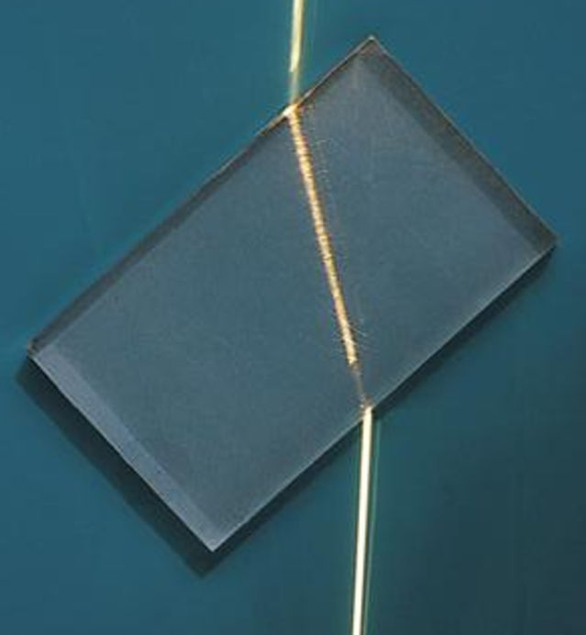

What is Refraction
“Refraction, in physics, the change in direction of a wave passing from one medium to another”
Why?
Where is this seen?
Water
Lens- Glasses
Rainbows
Prisms
Binoculars

Slide 4
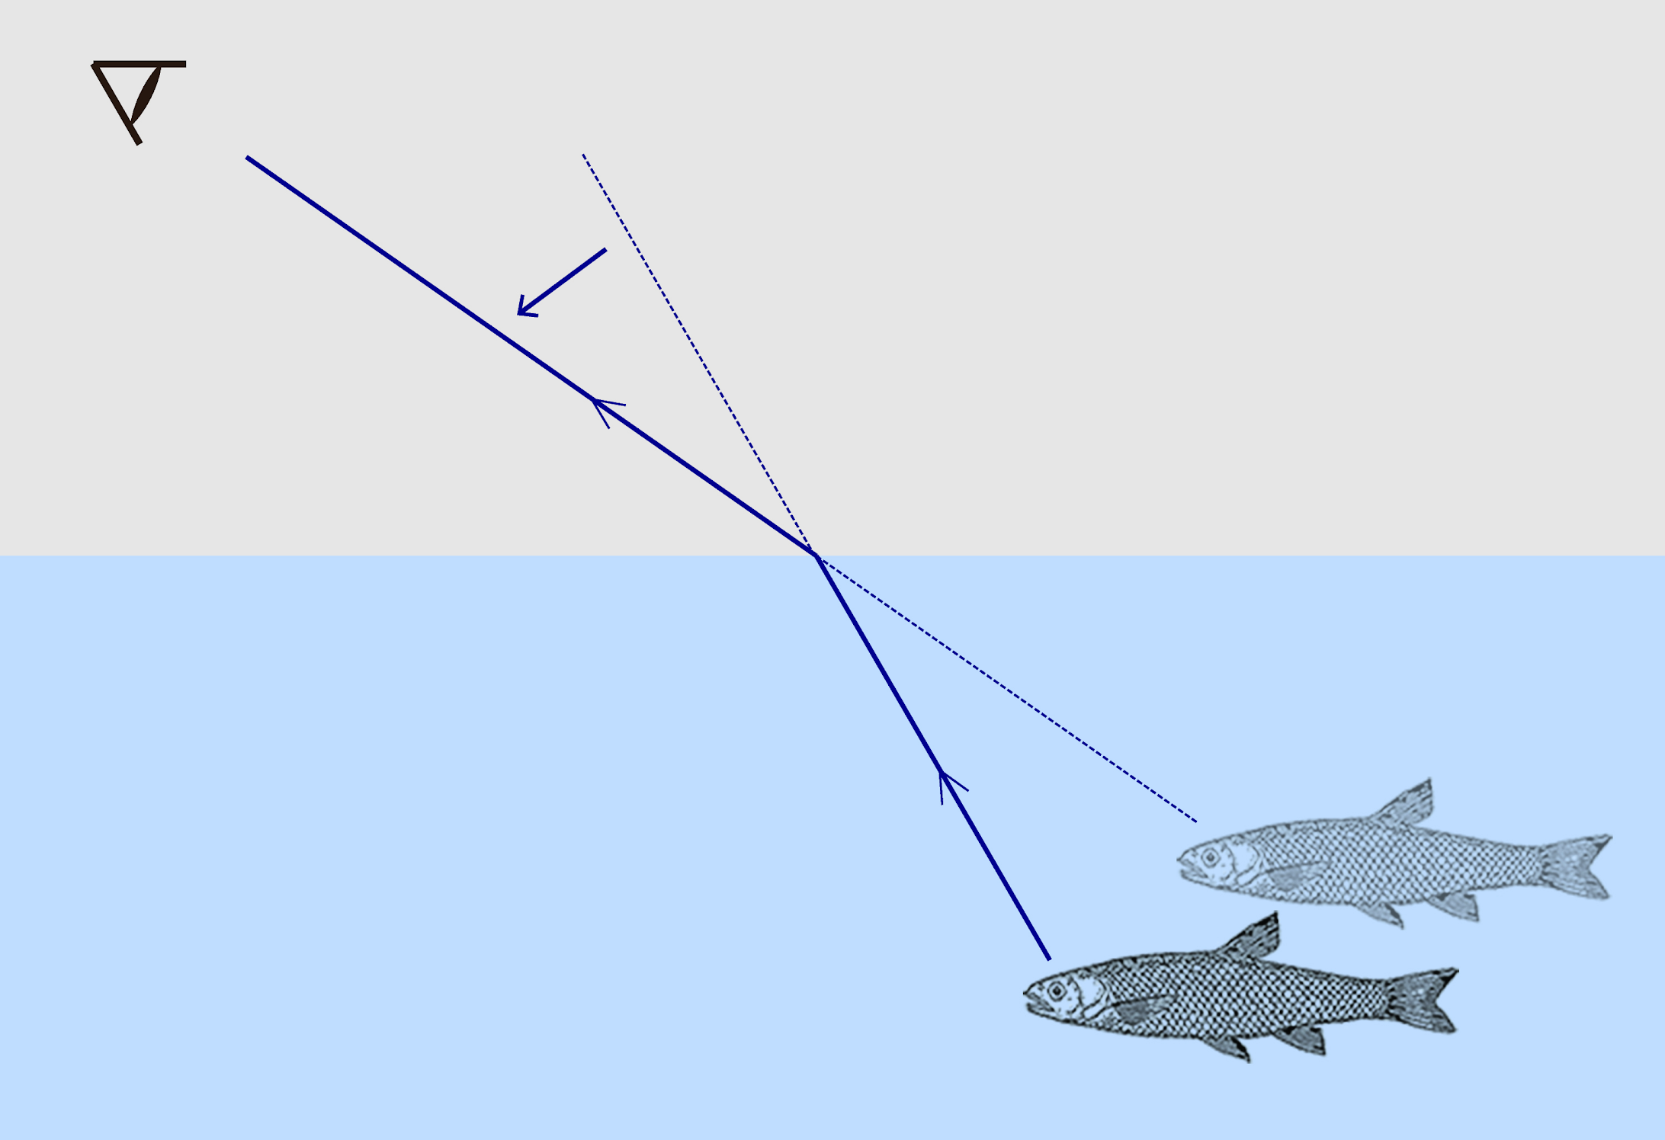

Water
Fish in a Pond
Light bends when it hits water
Eyes do not Compensate
Object is Lower Down and Farther than Image

Slide 5
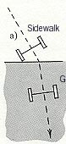
Why?
Lawn Mower on grass
Lawn Mower is going straight and right wheel hits Grass
The wheel on grass moves slower than left wheel
The Lawn Mower turns
After the second wheel hits the grass the mower goes straight

Slide 6
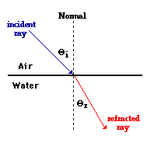
Terms, Part 1
Medium: What the light is traveling through
Refractive Index: Ratio of speed of light in different mediums
Interface: The “border” between the mediums
Normal: Line Perpendicular to the interface
Incident Ray: Ray going into the interface
Refracted Ray: Ray leaving the interface

Slide 7
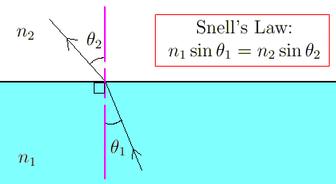
Terms Part 2 (and a bit of math)
Incident Angle: The Angle Between the Incident ray to the Normal, not the Interface
Refracted Ray: The Angle Between the Refracted ray to the Normal, not the Interface
Snell’s Law, the Math:
In General
High to low Refractive index: Bends light away from normal
Low to High refractive index: Bends light towards normal

Slide 8
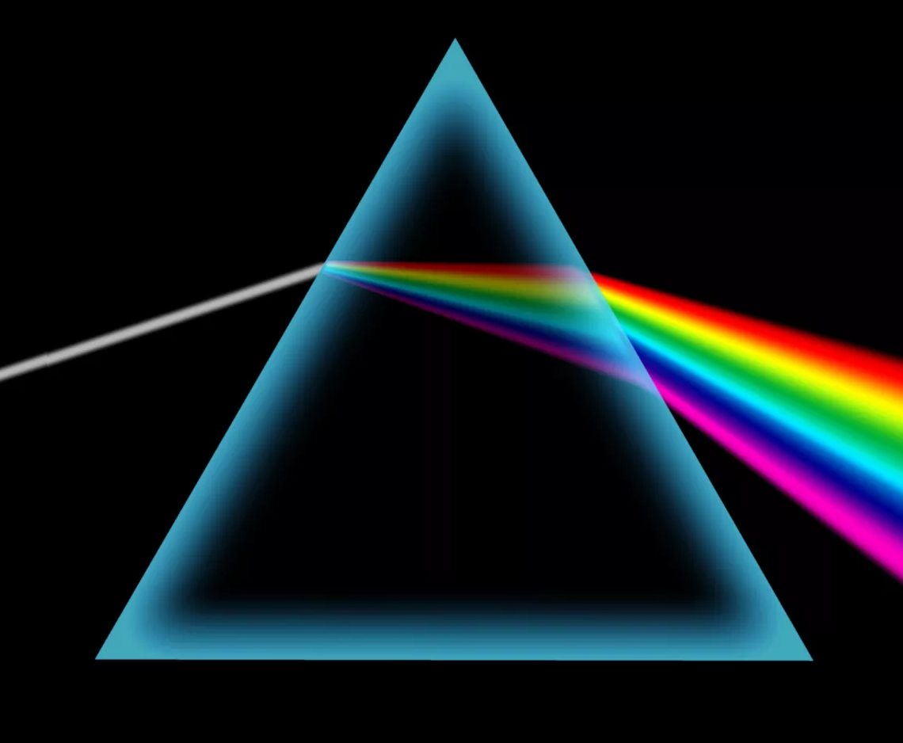

Refraction and Rainbows
Refraction Makes Rainbows!!!
Different Color have Different refractive indexes
White light = All the colors combined
Colors separate
Rainbow!

Slide 9

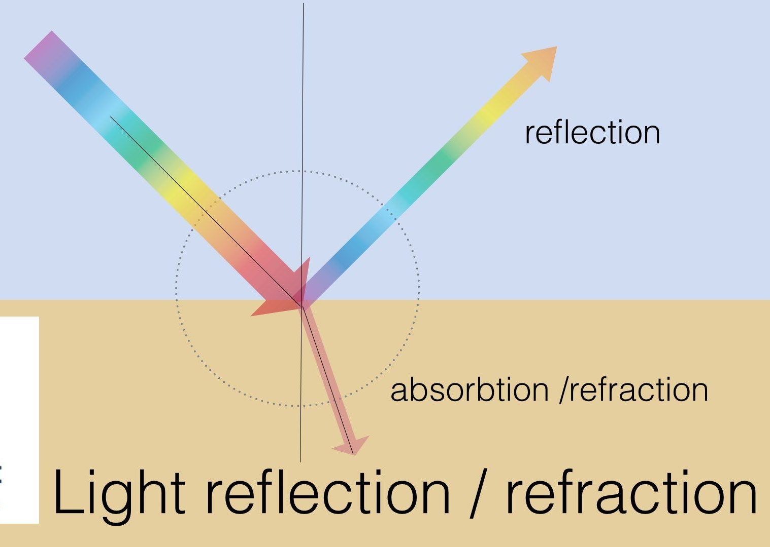
Refraction and Reflection
When light hits a interface, it boths Reflects and Refracts
Water: Reflection and Refraction
Advanced: Brewster’s Angle
Colors?

Slide 10
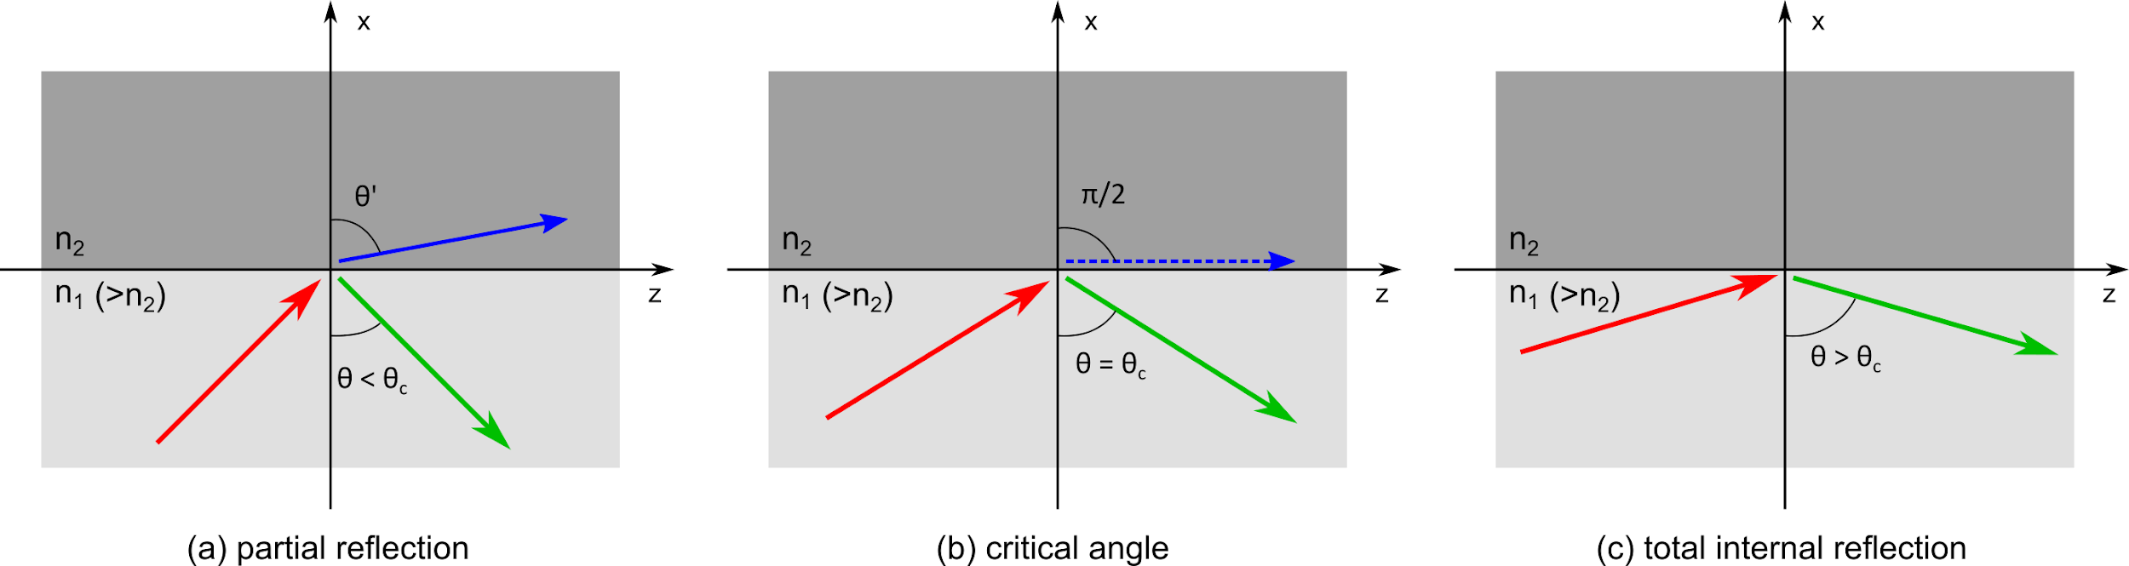
TIR: Total Internal Reflection
What if everything is a reflection?
How does it work?
What are some uses?

Slide 11
Review
What is Refraction?
What are some substances that refract waves?
If an incident angle is 60 degrees, how many degrees is it away from the normal?
When a wave hits water, does it refract or reflect?
What is total internal reflection useful for?

Slide 12
Diffraction

Slide 13
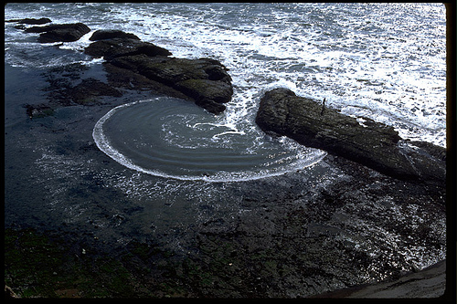
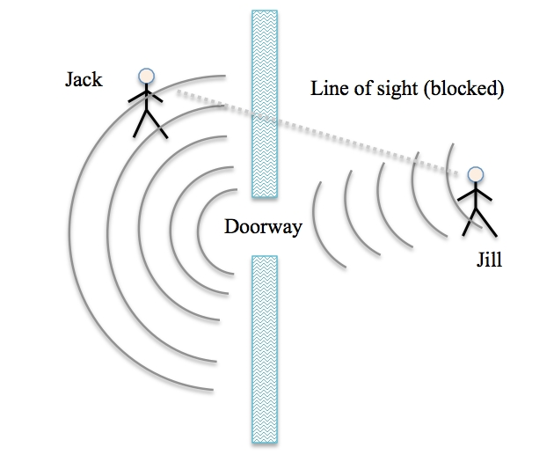
Diffraction
Waves “bend” around objects
Why can we hear sound around a doorway?

Slide 14
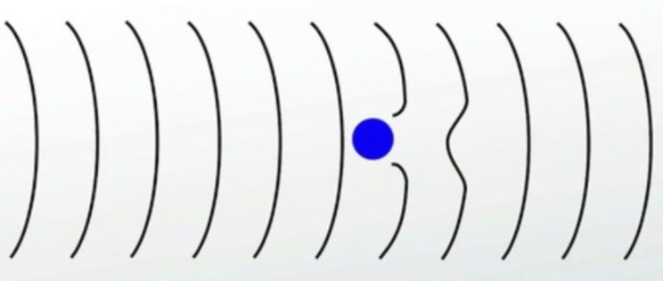
Non-slit diffraction
Waves can easily bend around objects.
Why can we hear sound around a post?

Slide 15
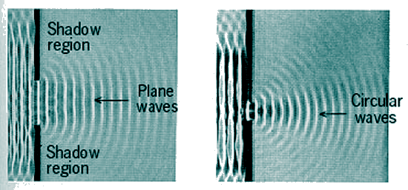
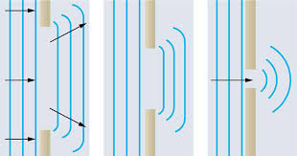
Large vs small slits
The smaller the slit, the more obvious the diffraction
Diffraction occurs because there’s a barrier; the closer the two sides of the barrier are to each other, the closer the diffraction effects of the top and bottom are

Slide 16
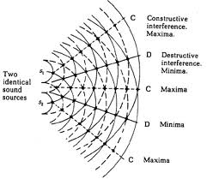
Interference?
Last week we saw this image with two point sources. . .
How can we create point sources?

Slide 17
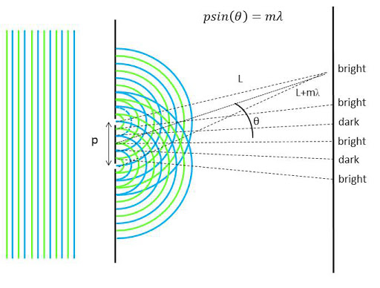
Diffraction interference!
We can see “dark” and “light” spots on the wall if we send a light wave into 2 slits. Why?

Slide 18
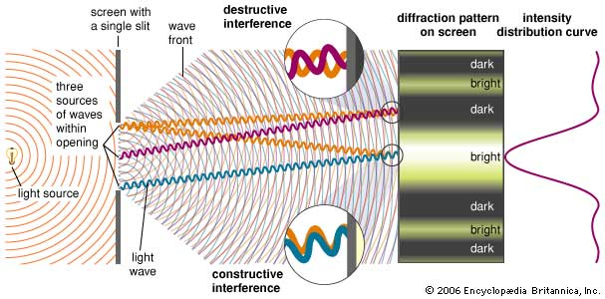
Single slit diffraction???

Slide 19
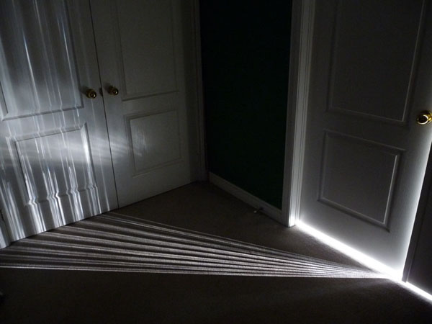
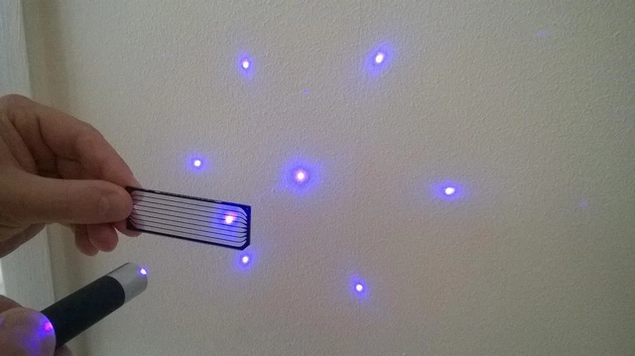
More diffraction examples
It’s a single slit, so why do we see dark/light spots?

Slide 20
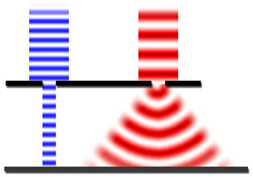
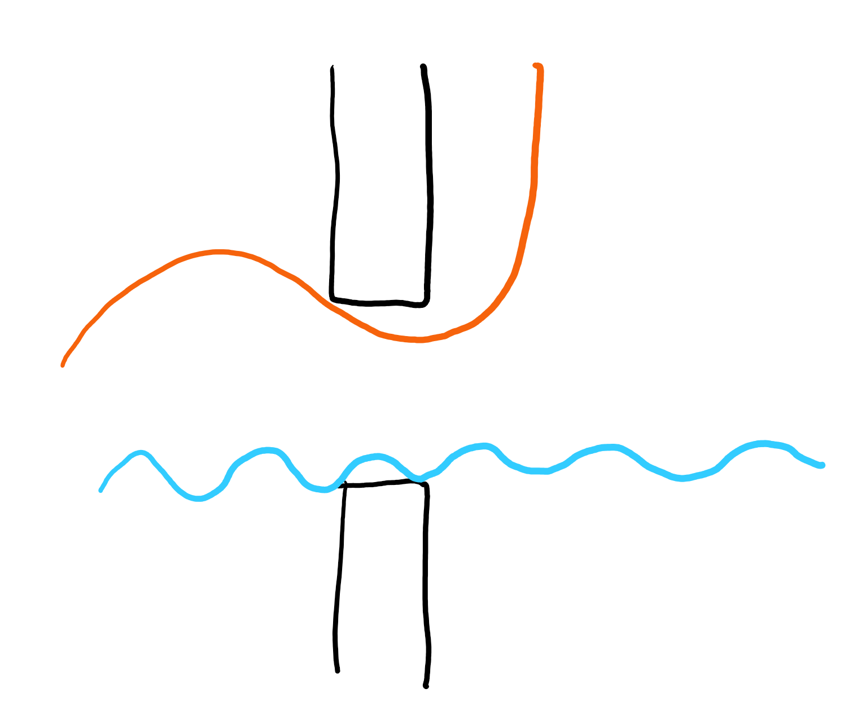
Wavelength
Longer wavelengths diffract more!
More likely to bend

Slide 21
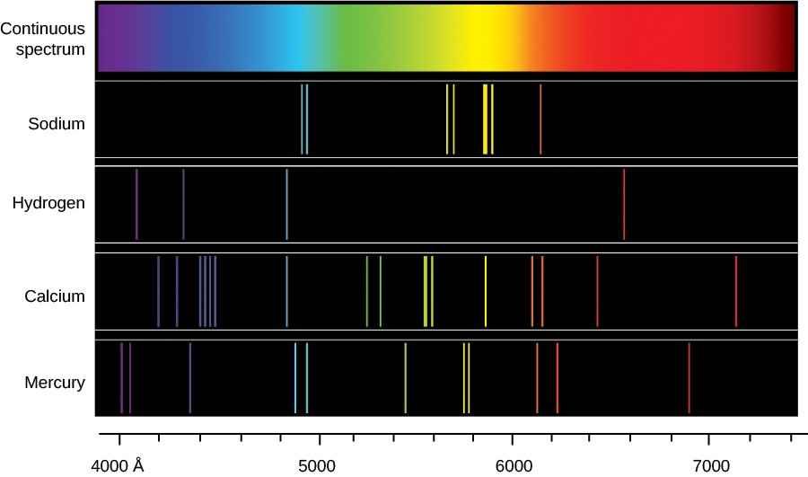
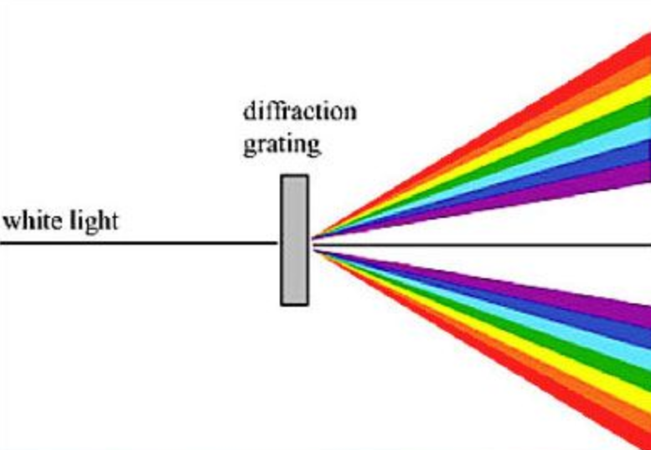
Spectral lines?
Separate colors so we can see which colors exist!

Slide 22
Review
What is diffraction?
Where do we see this?
What role does the length of the slit play?
What role does wavelength play?
How does this help us see interference?

Slide 23
Pog principle!?

Slide 24
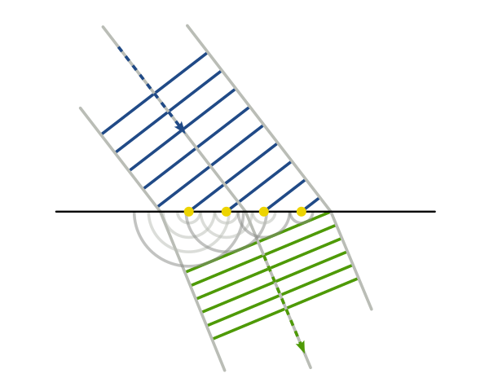
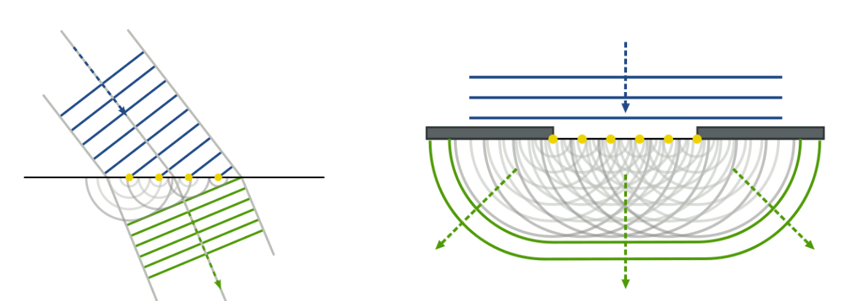
Huygen’s principle
What shape is the wave when we throw a pebble in water?
All waves act as point sources; explains refraction/diffraction!

Slide 25
Scattering

Slide 26
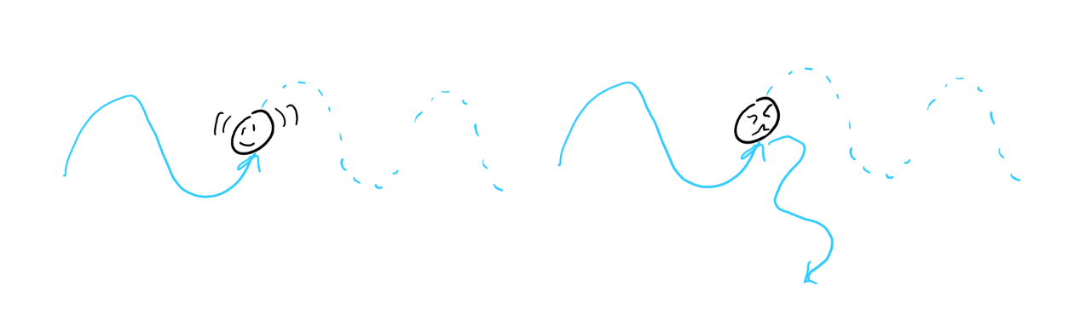
Scattering
Particles absorb and reemit waves

Slide 27
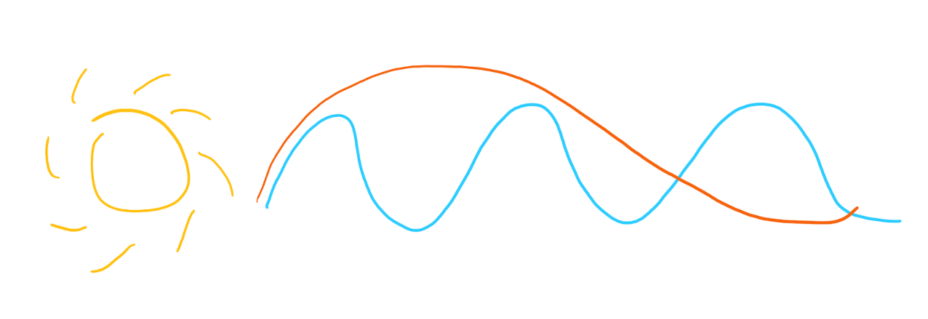
Different colors
You’re more likely to be hit by a wave with a shorter wavelength. Why?

Slide 28
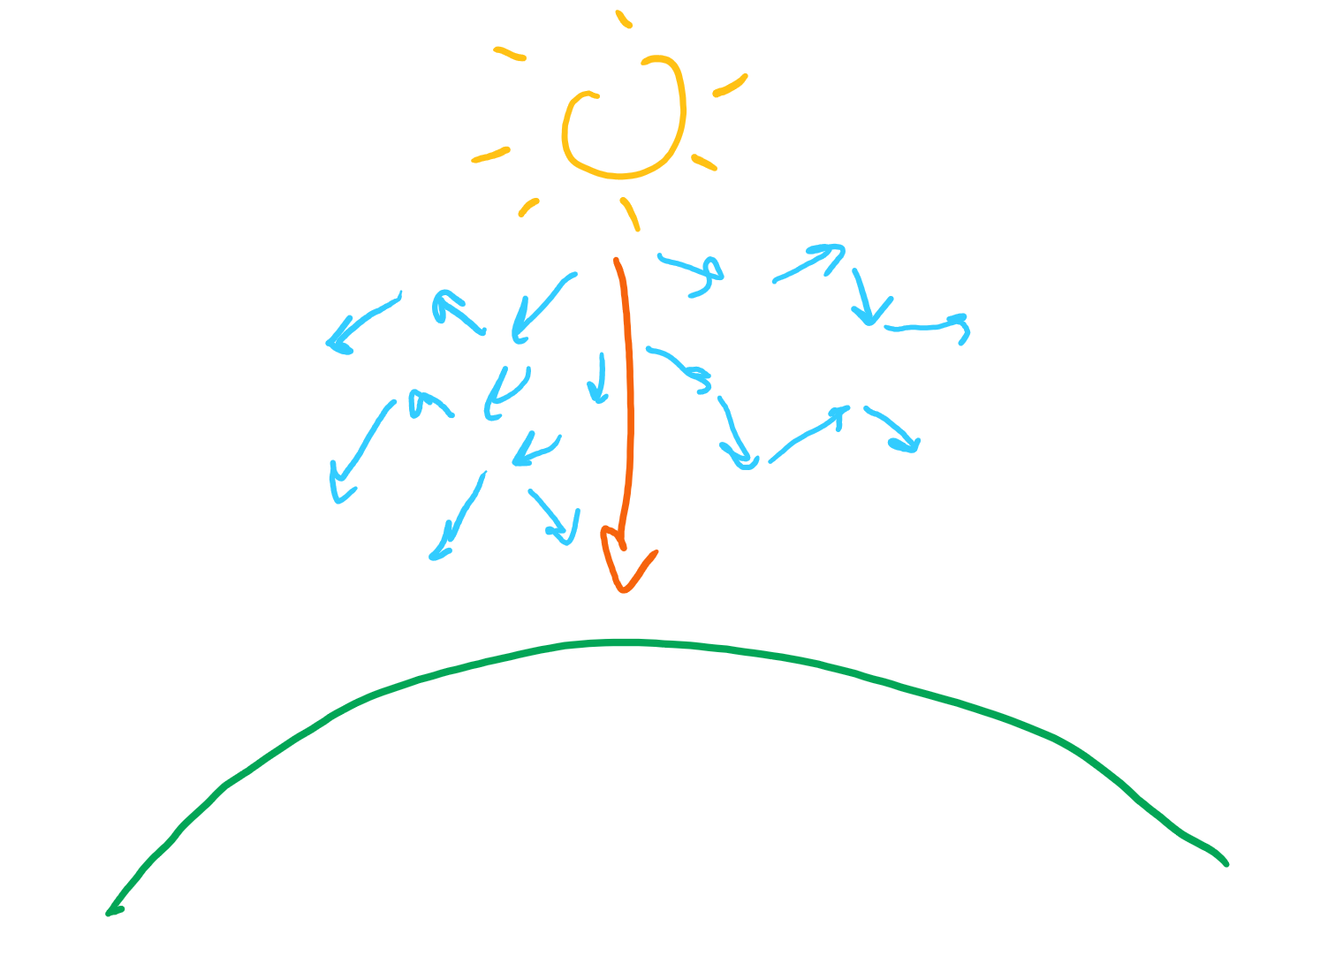
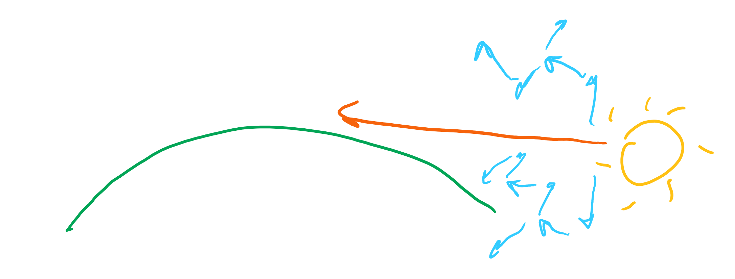
Day, dusk, and dawn
Orange-ish light comes only when we look in the direction of the sun; blue light is scattered everywhere. What does this mean?

Slide 29
Review
What role do atoms have in scattering light?
What wavelengths are scattered more?
Why is the sky blue?
Why is a sunset and sunrise red-ish orange-ish?

